Slide 1
SUPER STORE SALES ANALYSIS
End To End Data Analytics Project/ SQL/EXCEL
Name : Tina Chaudhari
Date : 27/03/2026

Slide 2

INTRODUCTION
This project analyzes a retail Superstore dataset.
Objective:
- Understand sales and profit trends
- Identify top-performing segments and categories
- Analyze impact of discounts
- Provide business recommendations
-Dataset includes order-level transactional data.

Slide 3
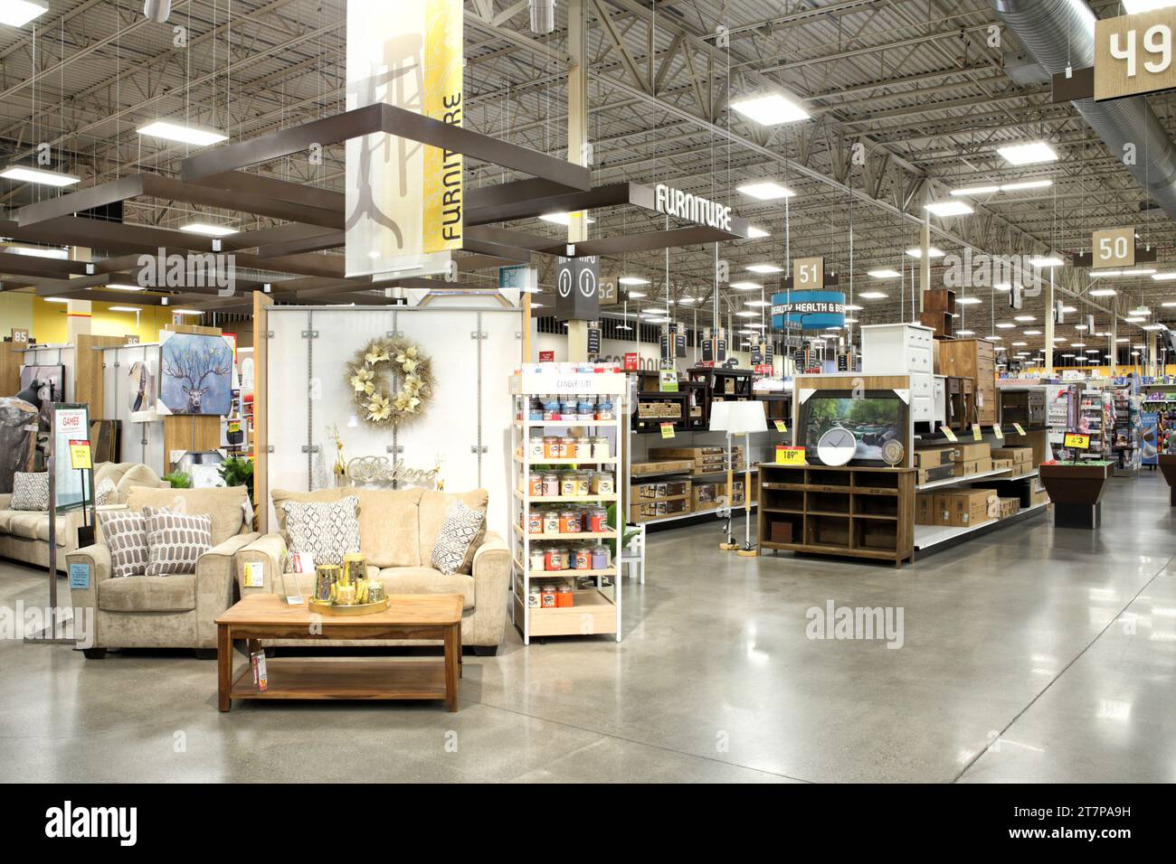
DATASET DETAILS
SEGMENT
1-
CONSUMER
2-
CORPORATE
3-
HOME OFFICE
Continue

Slide 4
CATEGORIES
1-
TECHNOLOGY
2-
FURNITURE
3-
OFFICE SUPPLIES
1) ACCESSORIES
2) APPLIANCES
3) MACHINES
4) SUPPLIES
5) PHONES
1) CHAIRS
2) TABLES
3) FURNISHING
1) ART
2) BOOKCASES
3) COPIERS
4) ENVELOPS
5) LABELS
6) PAPER
7) BINDERS
8) STORAGE
Continue

Slide 5
REGIONS
1-
EAST
2-
WEST
4-
SOUTH
3-
CENTRAL
SHIP MODE
FIRST CLASS
SECOND CLASS
STANDARD CLASS
SAME CLASS
Continue

Slide 6
0THER COLUMNS IN DATASET
ORDER ID, ORDER DATE
COUNTRY, CITY, STATE
DISCOUNT, PROFIT
POSTAL CODE, SALES, QUANTITY
Note:-
1) Order ID is the unique identifier in data base .
2) Country is the “UNITED STATES”.

Slide 7

Which segment generates highest profit?
Which category performs best?
BUSINESS PROBLEM
Which region has highest/lowest sales?
How discount affects profit?

Slide 8

Total Profit: 2,85,911
Average Discount: 0.156
Total Sales: 22,95,455
KEY PERFORMANCE INDICATORS (KPIS)
Total Sales: 22,95,455
Total Profit: 2,85,911
Average Discount: 0.156
Profit Margin Analysis

Slide 9
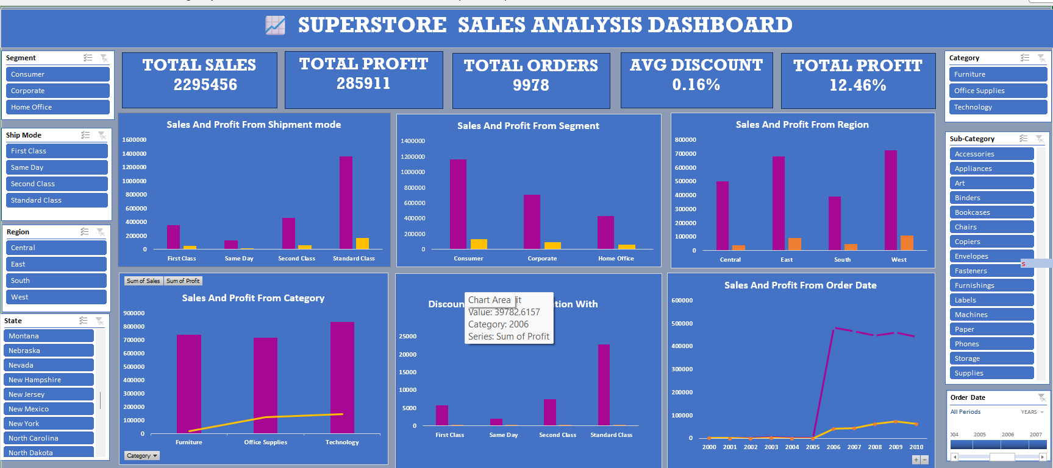

Slide 10
SEGMENT ANALYSIS
Consumer Segment
Corporate Segment
Home Office
Highest Sales and Profit
Moderate Performance
Lowest Sales and Profit
CATEGORY ANALYSIS
Technology
Office Supplies
Furniture
Highest Sales and Profit
Moderate Performance
Lowest Profit

Slide 11
REGION ANALYSIS
West
East
Central & South
Highest Sales (31%.58%)
Second Highest
Lower Performance
High discounts reduce profit significantly
DISCOUNT ANALYSIS
MINIMUM DISOUNT-0
MAXIMUM DISOUNT-0.8
AVERAGE DISOUNT-0.156
High Discounts Reduce Profit Significantly

Slide 12


PROFIT MARGIN ANALYSIS
Technology
Furniture
Highest Margin (~17%)
Second Highest
Indicates Inefficiency in Furniture Category
TOP PERFORMING LOCATIONS
Top City
Top State
New York City
California
These Locations Generate Highest Revenue And Profit

Slide 13

LOSS ANALYSIS
Some Cities Generate Negative Profit
Reasons:-
-High Discount
-Low Demand
-Poor Pricing Strategy

Slide 14
KEY INSIGHTS
Consumer Segment Dominates
Technology Drives Profit
West Region Performs Best
High Discount Reduces Profitability

Slide 15
RECOMMENDATIONS
Reduce Unnecessary Discounts
Focus on Technology Category
Improve Furniture Profitability
Target high-performing regions

Slide 16
CONCLUSION
Business is Profitable Overall
Growth Driven by Technology & Consumer Segment
Improvement Needed In Low-performing Areas
Target High-performing Regions

Slide 17


